Slide 1
Why is % identity not a good measure for the the quality of a blast hit?

Slide 2
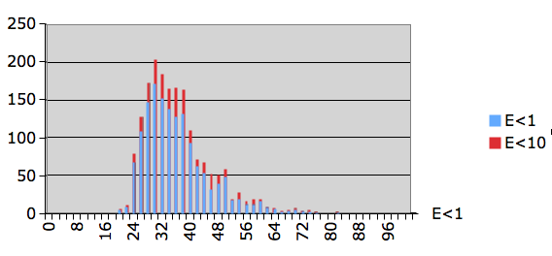
Histogram of percent identity for significant and insignificant hits

Slide 3
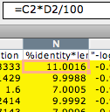
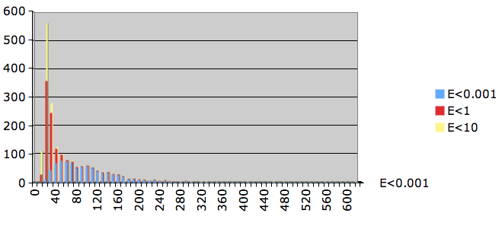
Number of identical residues for significant and insignificant hits

Slide 4
GCBias in a window (G-C/(G+C))

Slide 5
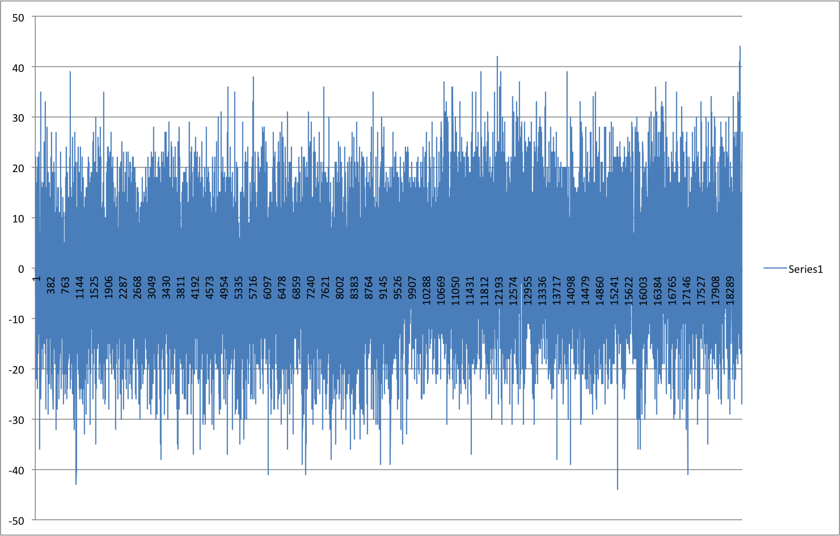
Window=100 , printed every 100

Slide 6
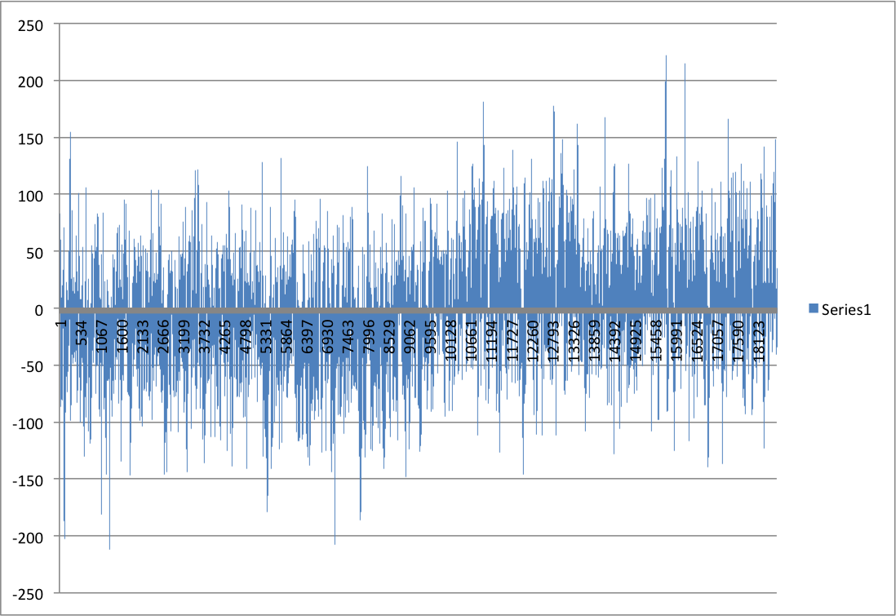
Window=1000 , printed every 100

Slide 7
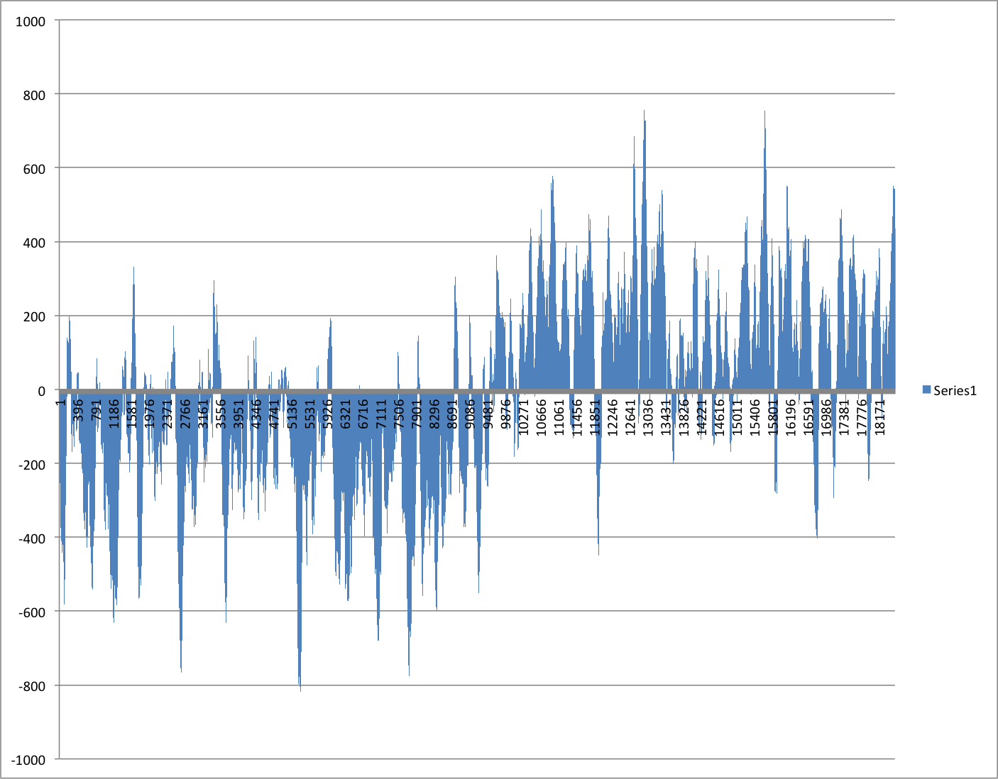
Window=10000 , printed every 100

Slide 8
Cumulative GCSkew
SUM(C-G) measured along the genome from the ORI

Slide 9
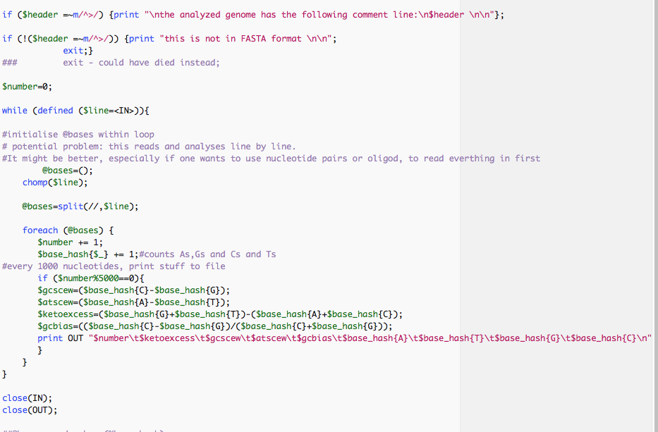
Part of script to calculate cumulative GC bias

Slide 10
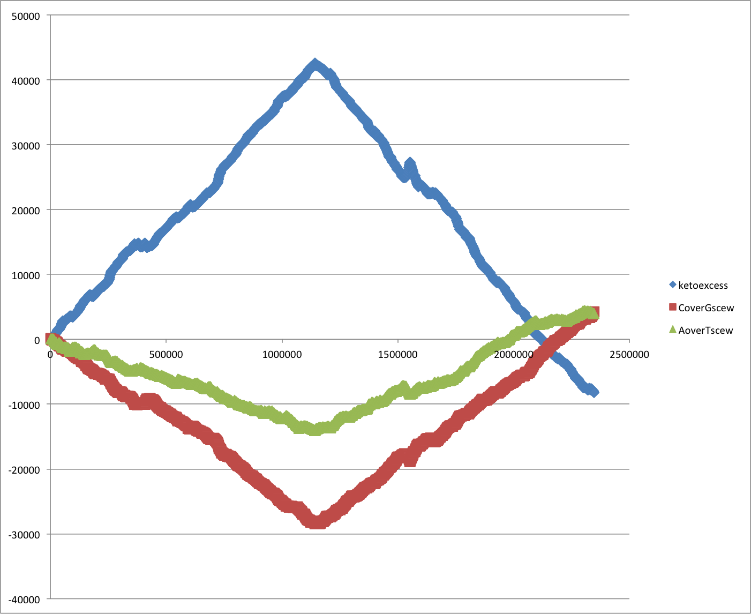
Cumulative Strand Bias SG0

Slide 11
Tetramer bias for Thermus thermophilus SG0
Oligonucleotide bias (how often does an oligonucleotide occur on one strand minus occurrence on the other strand)

Slide 12
Within genome recombination

Slide 13
Aeromonas_hydrophila_ML09_119_uid205540 versus Aeromonas_salmonicida A449
Notes:
About 26 recombination events equidistant to the ORI

Slide 14
Aeromonas_veronii B565 versus Aeromonas_hydrophila_ML09_119_uid205540

Slide 15
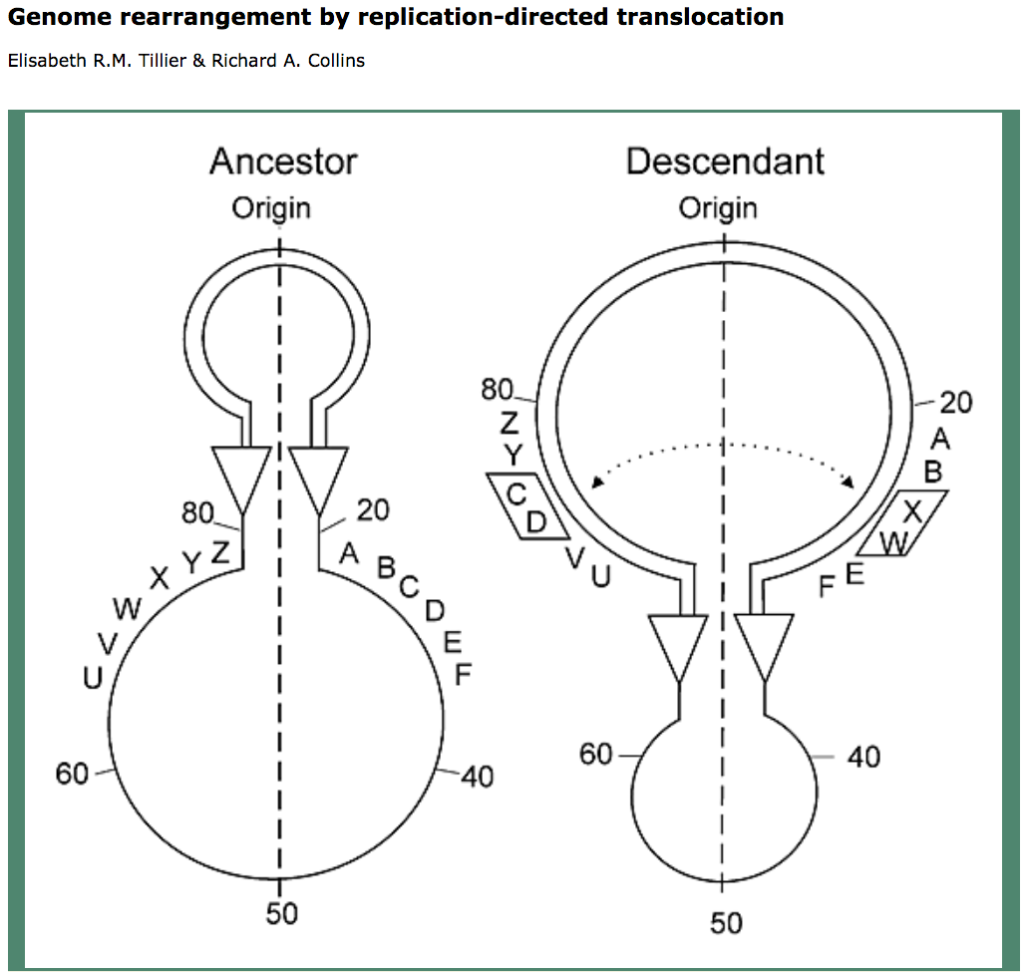
Two Reasons for Recombination Patterns in Microbial genomes:
A) Recombination events occur at the time of replication
Figure 2. Rearrangement of gene order by translocation of genes across the replication axis.
A hypothetical ancestral gene order is indicated (left). After passage of the replication forks (triangles), genes C and D have exchanged positions with W and X by translocation across the replication axis (vertical dashed line) in the descendant genome. For simplicity, the diagram shows a reciprocal translocation that might occur in a single round of replication through two reciprocal recombination events. The diagram does not specify a mechanism for the translocation of genes, which may also occur in several steps as a series of recombination events in separate rounds of replication through intermediate genome organizations. The two replication forks are proposed to be across the replication axis and physically close together, promoting translocation of sequences at the forks. Numbers indicate the percentage of distance from the origin.

Slide 16
Two Reasons for Recombination Patterns in Microbial genomes:
B) Recombination events that do not occur in a symmetric fashion result in misplaced Genome Architecture IMparting Sequences (AIMS)
dnaA boxes
one way signals for the replication fork, ter sites , tus binding

Slide 17
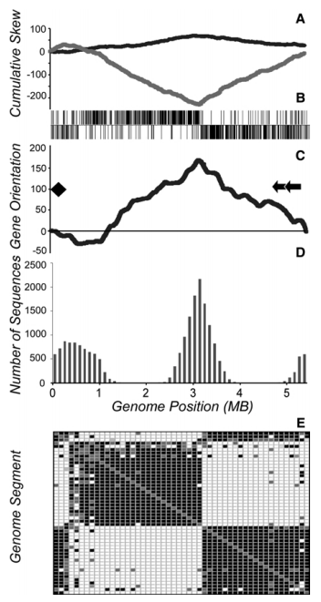
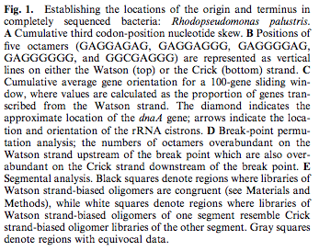
Selection for Chromosome Architecture in Bacteria

Slide 18
Go through array-scalar_example.pl

Slide 19
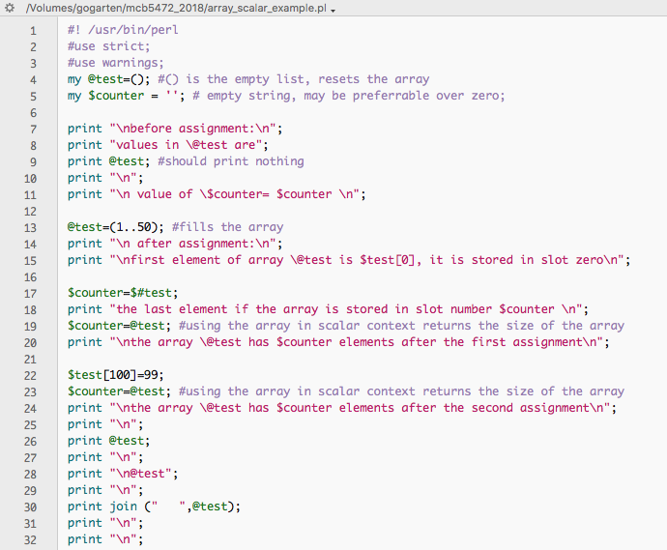

Slide 20
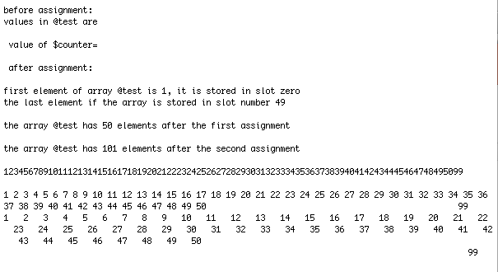

Slide 21
Past Assignments

Slide 22
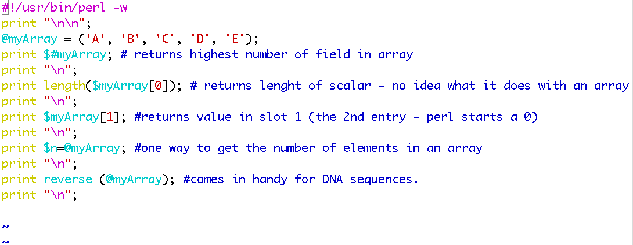
From Wednesday:
For the following array declaration @myArray = ('A', 'B', 'C', 'D', 'E'); what is the value of the following expressions:
$#myArray length(@myArray) $myArray[1] $n=@myArray reverse (@myArray)
4
1
B
5
EDCBA
Run and discuss class03_answers.pl (see scripts folder) or here and here

Slide 23
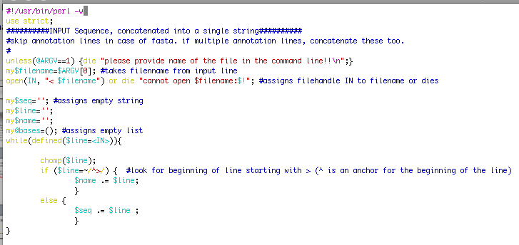
%GC counter, part A: read in seqs

Slide 24
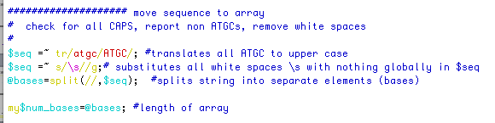
%GC counter, part B: move seqs to array

Slide 25
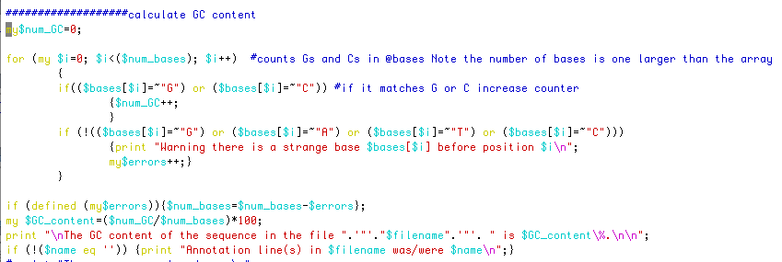
%GC counter, part B: calculate %GC

Slide 26
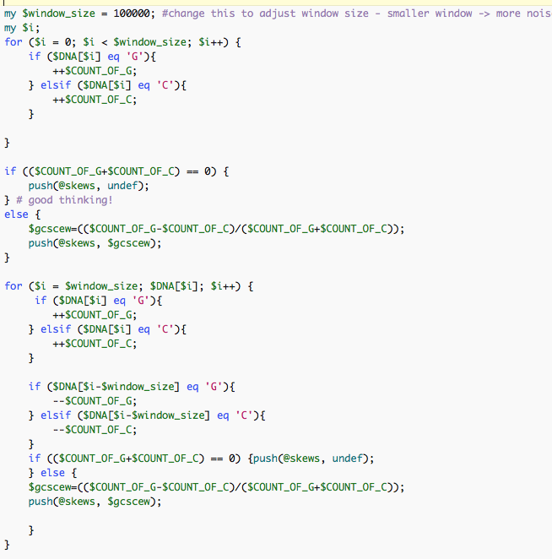
G-C/(G+C) in a window

Slide 27
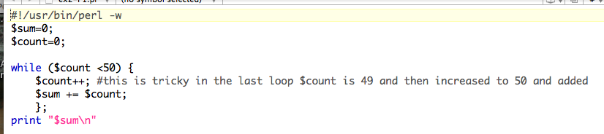
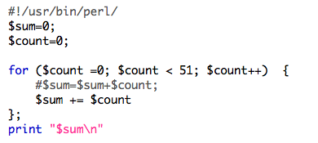
Control structures: Sum 1..50
while ( ) { }
for ( , , ) { }

Slide 28
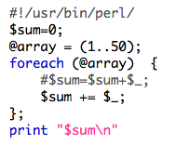
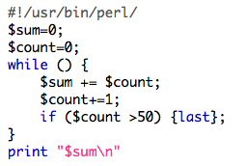
Control structures: Sum 1..50
foreach ( ) { };
Infinite loop with last:
while () {
if( ) {last};
};

Slide 29
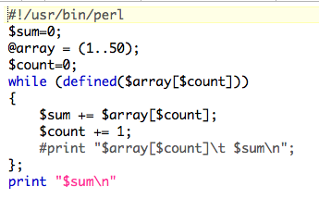
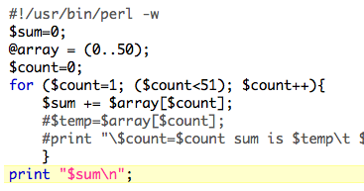
Control structures: Sum 1..50
while (defined ( )) { };
for ( , , ) { }
Counting elements of an array
Could have started at 0

Slide 30
Hashes are tables that relate keys and values.
(in the array the number of the field could be considered the key:
@a=(1..51) => $a[0]=1, $a[50]=51 )
In a %ash the entry for the key is the address where the value is stored.
E.g., you could have a hash where the students age is stored as value and the student ID is the key.
But you also could use the students name as key and the ID or age or …. as value. This works very economically, especially if the table is sparse.
my (%studentID, %student_first_name, %studentGPA);$studentID{gogarten}=9999;
$student_first_name{gogarten}=‘Johann Peter’;
$studentGPA{gogarten}=“nd”;
In many instances you need to make sure that the key you want to use has not yet been assigned. If (exists ($studentID{gogarten}) {};
Go through class04_2018.pl
http://gogarten.uconn.edu/mcb5472_2018/class04_2018.pl
http://gogarten.uconn.edu/mcb5472_2018/gi_list.txt

Slide 31
For Next Monday
Write a script that reads in a sequence and prints out the reverse complement.
Modify your script to that it can handle a sequence that goes over several lines.
Background: $comp =~ tr/ATGC/TACG/;
#translates every A in $comp into a T; every T into an A; every G into a C and every C into a G
Read P10 From strings to arrays and back
Read P 14 on hashes, write the program suggested in the chapter (P14.1-P14.3)
Solve the tasks given in class04_2018.pl

Slide 32
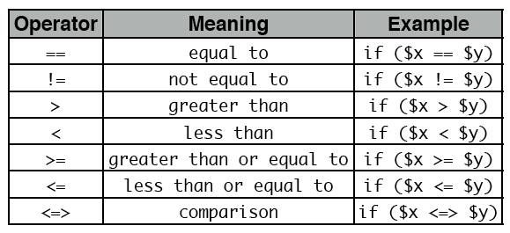
For Next Monday (cont.)
Do the following statements evaluate to true or false? (Check P5)
1
0 && 1
0||1
45
45-45
45/45
45==45
45<=50
$a=45
50 <=> 70
70 <=> 70
70 <=> 50
45!=45
45!=50
from http://korflab.ucdavis.edu/Unix_and_Perl/current.html#part3

Slide 33
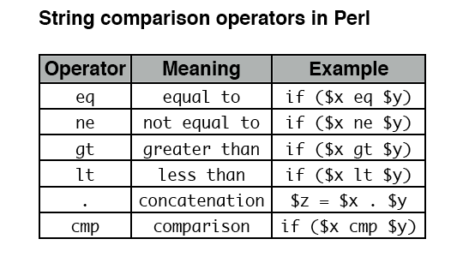
From P6 in http://korflab.ucdavis.edu/Unix_and_Perl/current.html#part3

Slide 34
Most of the smaller assignments should be solvable within half an hour. Using the notes, the text book and the internet try to solve one problem for not more than one hour. Then ask me or Dyanna for help.
In total, the assignments for one week might take a few hours, but if it goes beyond 3 hours total, ask for help, or hand in the latest version of your attempt to solve the assignment. Sometimes, a little help can go a long way. The main reason for the assignments is to make you actually write code and to learn form the mistakes you make.

